Slide 1
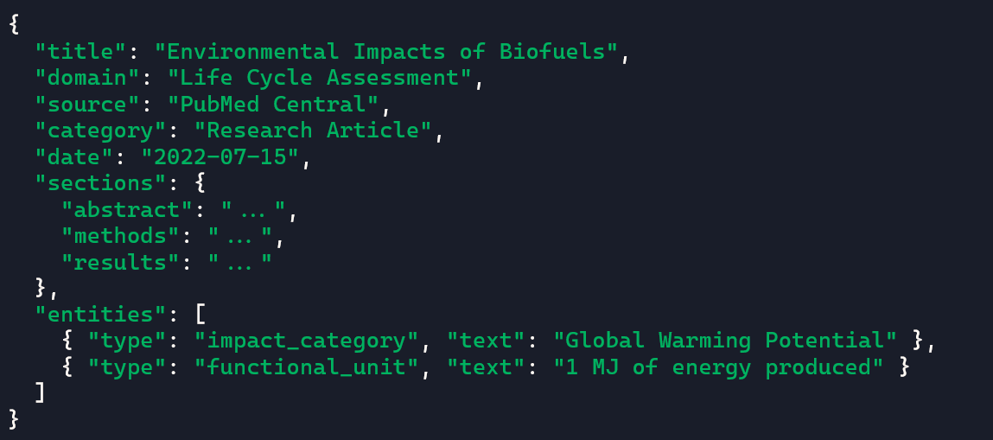
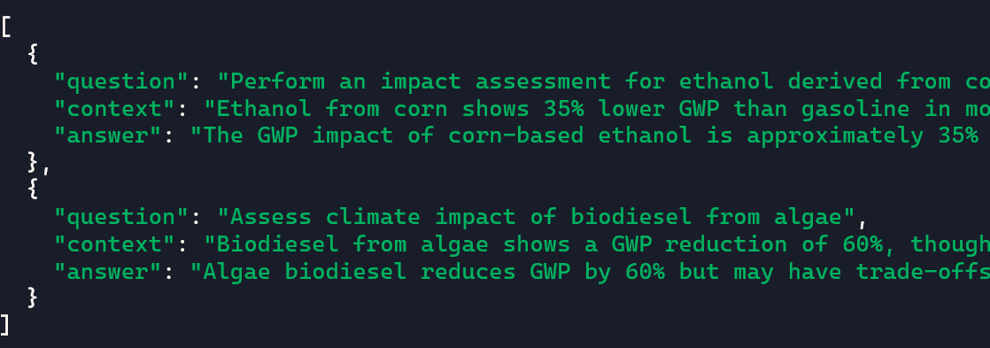
Json format:
RAG Procedure Workflow
Raw text -> structured / categorized text
Entity recognition
Section Segmentation
Text Chunking
Tools (Python library):
ScaCy
GROBID
Categorized test -> formatted json
Use python library 'json' for text-json converstion
Use library 'from jsonschema import validate' to validate the correct json format before putting in DB
Store the json files in DB (suggest: MongoDB) (optional)
Embedding of formatted json data to vector-based data
Chunk text for embedding (define chunks and metadata)
Embed chunked text with (from sentence_transformers import SentenceTransformer)
Index with FAISS (act like a memory of a computer that handles and stores embedded data)
use LangChain for simulating the LLM workflow (from retrieving data to query output, with openAI api, ready for RAG LLM)
-Check if the previous process were completed in expectations
Few-shot Prompt Template Creations & Quality Validation
From langchain.prompts import PromptTemplate
From jinja2 import Template
Few-shot template:

Slide 2
Connect to Brightway2 Engine
Explore Brightway2 to be a custom tool in LangChain to achieve tight automation of the whole process.
RAG LLM model
Brightway2 Engine
RAG LLM model
(Rain)
(Feiya)

Slide 3
Progress:
7/7 - 14/7
  Learned the crucial components of RAG LLM
  Built the foundation framework of the RAG LLM from text extraction to query
    Text Extraction
    Structured text into different categories: title, source, sections: introduction, results…
    Write vector-based index based on extracted text
    Incorporating our vector-based indexes with local serving LLM to generate technical outputs

Slide 4
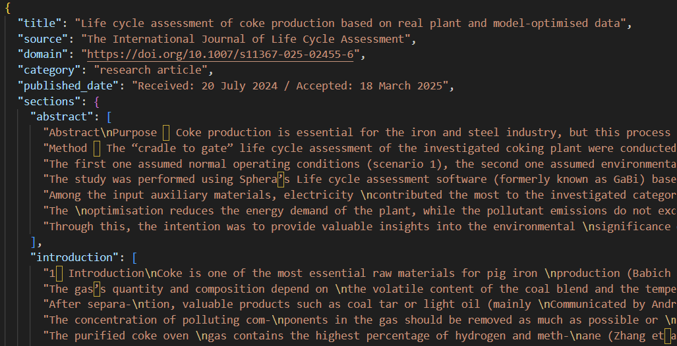
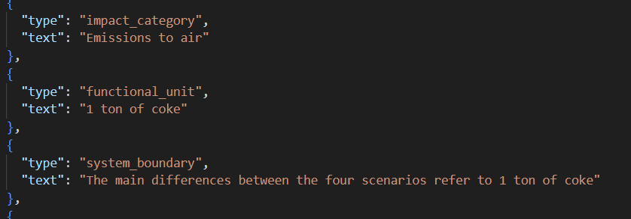
Process pdf to structured data
Extract and categorize the academic journals:
Title
Source
Domain
Category
Published Date
Sections (Text pattern)
  Abstract
  Introduction
  Methodology
  Results
  Discussion
  …
Entities (Assisted by local AI)
  Type
    System boundary, functional units, impact category…
  Text
    Scopes, 1 ton of coke, Emissions to air…

Slide 5

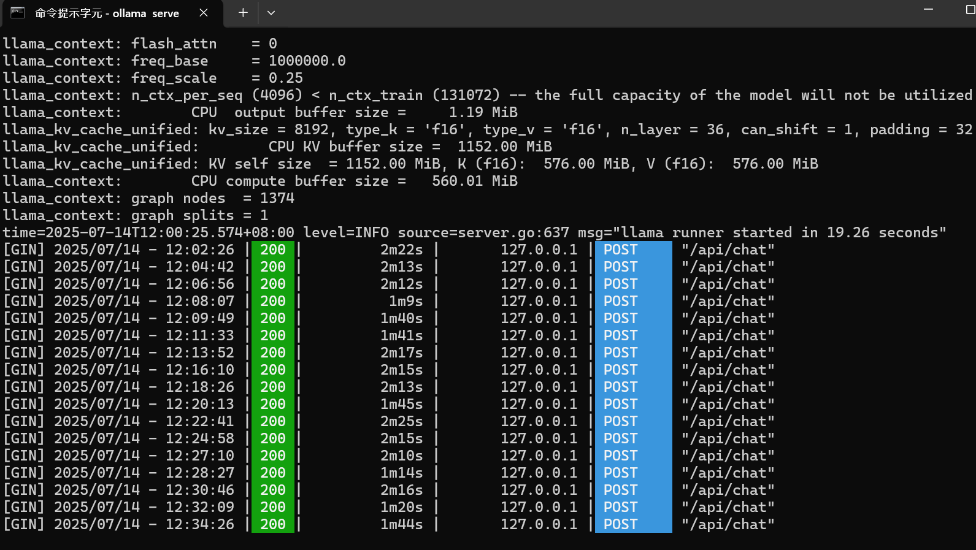
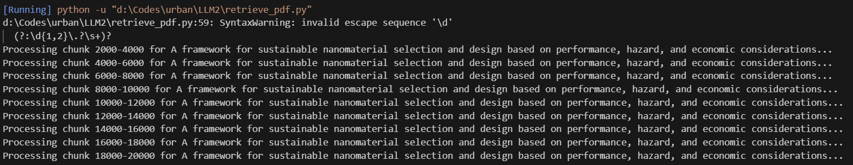
Local models for entities extraction and responding query
Ollama
Providing tools for downloading local LLM models
Model using: Deepseek-R1:8b
Extracting entities:

Slide 6
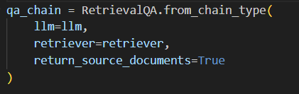
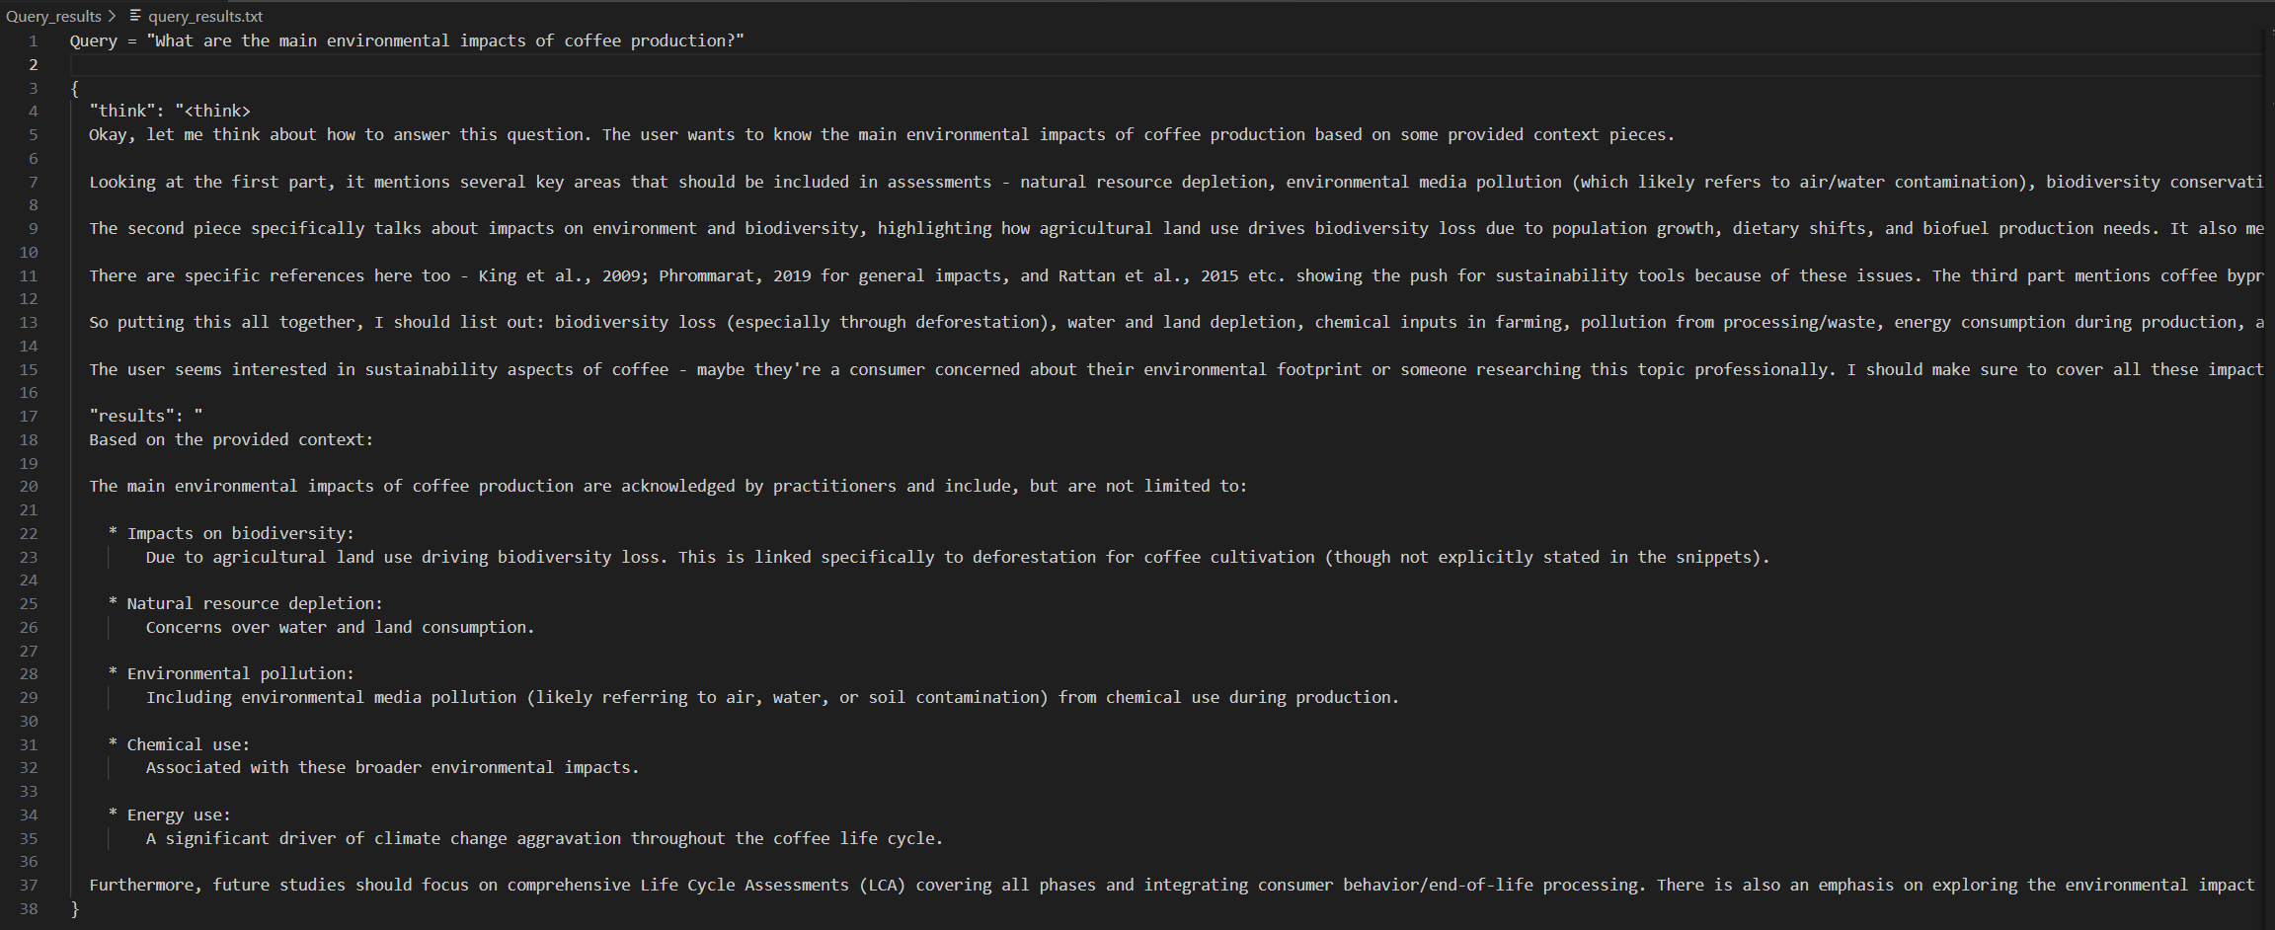
Write Index (Text -> Vector)
Convert json files to vector-based indexes
Query Index
  llm: Deepseek-R1:8b
  Retriever: Our vector-based indexes
  Output: {Think, Results}

Slide 7
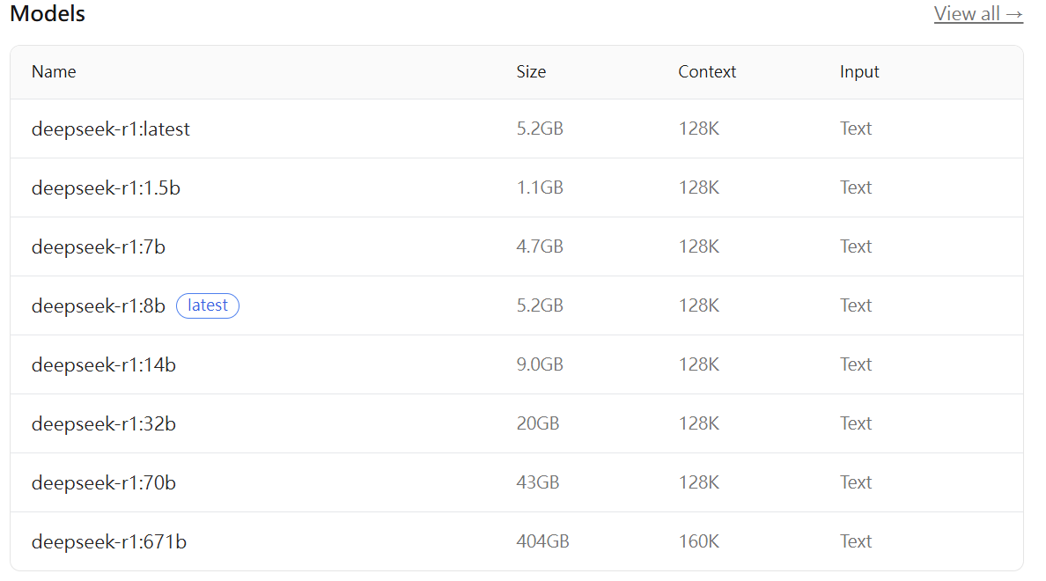
Challenges
Local LLM processing speed
Need good performance RAM and GPU for handling queries.
LLM duties:
  Identify the important entities described in the academic sources
  Incorporating with our vector-based indexes for generating results

Slide 8
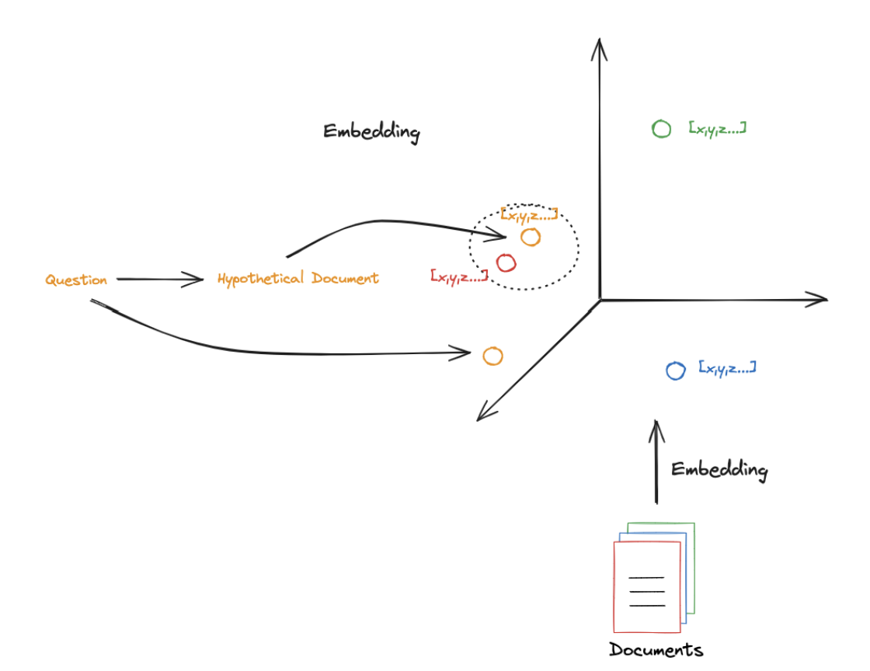
Integrating query methods to enhance output accuracy
HyDE:
Multi-query
Ranked query
HyDE
HyDE: https://arxiv.org/abs/2212.10496

Slide 9
What have been done?
Changing from Ollama local LLM to HuggingFace LLM library (python library)
To be done:
Testing the huggingface within a day
Integrate with the json input and output format of brightway2 engine (Tiangong and Ecoinvent)
Observations:
The SEE cluster does not operate on weekends.

